Slide 2
Centralizing & Simplifying Enterprise AI Workflows
with Envoy AI Gateway
Notes:
Today I would like to introduce you to a new open source project called Envoy AI Gateway built to centralize and simplify enterprise AI workflows

Slide 3
Addressing the Evolving Needs of AI Platforms
Shifting Requirements: The Gen AI era demands new capabilities from AI platforms beyond basic model deployment.
Centralized Access: The Envoy AI Gateway offers a standardized, controlled, and auditable way to access self-trained, open source, and commercial models.
Managed Credentials: Supports various methods to authenticate and manage requests to a wide range of AI models.
Cost Monitoring and Tuning: Provides integrated observability along with cost controls (e.g., token-based limits) to optimize expenses and mitigate risks.
Notes:
The Gen AI era has pushed us to rethink AI platform capabilities. It’s not just about model deployment anymore, it's about managing complex AI infrastructure and workflows.
The Envoy AI Gateway addresses these evolving needs by providing centralized, auditable access to various AI models, which makes it easier to maintain control and security.
It supports different methods for credential management, ensuring flexibility in how we authenticate and manage requests.
And with built-in cost monitoring and tuning, Envoy AI Gateway helps organizations optimize expenses and mitigate risks effectively.
https://konghq.com/products/kong-ai-gateway?utm_source=google&utm_medium=cpc&utm_campaign=ai&utm_term=ai%20gateway&utm_content=kong-ai-gateway_landing-page_search&gad_source=1&gclid=Cj0KCQjw1Yy5BhD-ARIsAI0RbXa-snXwRKs0J32fNDdUVRmyOrDJxr3F-MILEXGpLjWlixXMKPyi3D4aAqraEALw_wcB
https://www.solo.io/products/gloo-ai-gateway/

Slide 4

Introducing the Envoy AI Gateway
First CNCF Open Source AI Gateway Project: Backed by CNCF to democratize AI infrastructure for organizations of all sizes.
Collaborative Innovation: Jointly developed by engineers from Bloomberg and Tetrate, bringing together diverse expertise.
Built on Envoy Gateway: Leverages Envoy’s robust, scalable foundation, optimized for modern AI workloads.
Notes:
Envoy AI Gateway is the first open-source AI gateway backed by CNCF, making AI infrastructure more accessible to organizations of all sizes.
This project is a collaborative effort, bringing together engineers from Bloomberg and Tetrate to pool our expertise and create something impactful.
built on top of Envoy Gateway, leveraging its robust and scalable foundation, which is optimized to handle modern AI workloads.

Slide 5

Envoy AI Gateway: Bridging
infrastructure
and
innovation
Notes:
Envoy AI Gateway is designed to bridge the gap between infrastructure needs and AI innovation.
It allows us to integrate cutting-edge AI tools and frameworks into our existing infrastructure seamlessly.

Slide 6
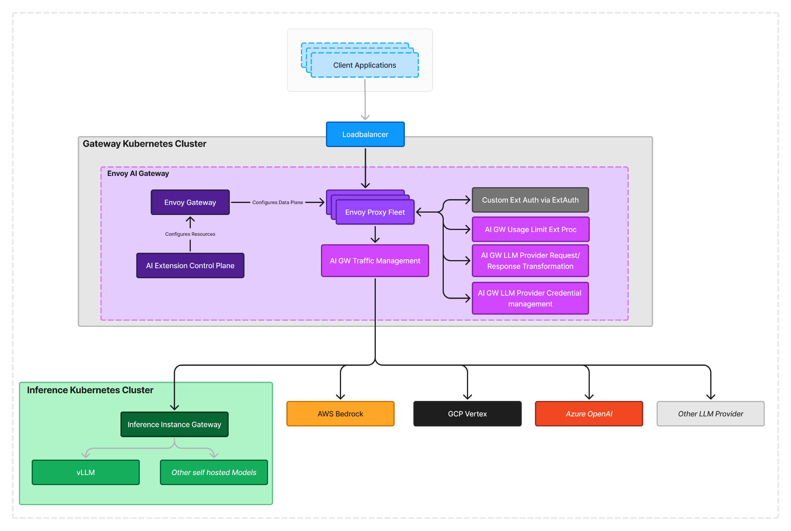




Envoy AI Gateway in AI Architecture Landscape
Notes:
This diagram illustrates how Envoy AI Gateway fits into the AI architecture landscape.
As you can see, it integrates with various components across cloud and on-premise environments, providing a unified entry point for managing AI workflows.
By centralizing access and simplifying integration, Envoy AI Gateway plays a pivotal role in enterprise AI architecture.

Slide 7
Extending Envoy Gateway
Built on Envoy’s Extensible Foundation: The Envoy AI Gateway utilizes Envoy’s modular design to seamlessly integrate with AI plugins.
Advanced Traffic Management: Enables intelligent traffic routing between on-premise and cloud environments for optimized performance.
Robust Fallback Mechanisms: Ensures reliability with automated fallback logic, maintaining service continuity across varied deployments.
Dynamic Provisioning and Configuration: Enables automated provisioning and configuration of managed Envoy proxies, allowing for real-time adjustments to optimize performance in order to meet changing workload demands.
Notes:
Envoy AI Gateway builds on Envoy’s extensible foundation, allowing us to easily integrate with different AI plugins.
It provides advanced traffic management, enabling intelligent routing across on-prem and cloud environments for optimal performance.
With robust fallback mechanisms, Envoy ensures reliability by maintaining service continuity even in diverse deployments.
And dynamic provisioning and configuration allow us to automate the setup of managed Envoy proxies, adapting in real-time to workload demands.

Slide 8
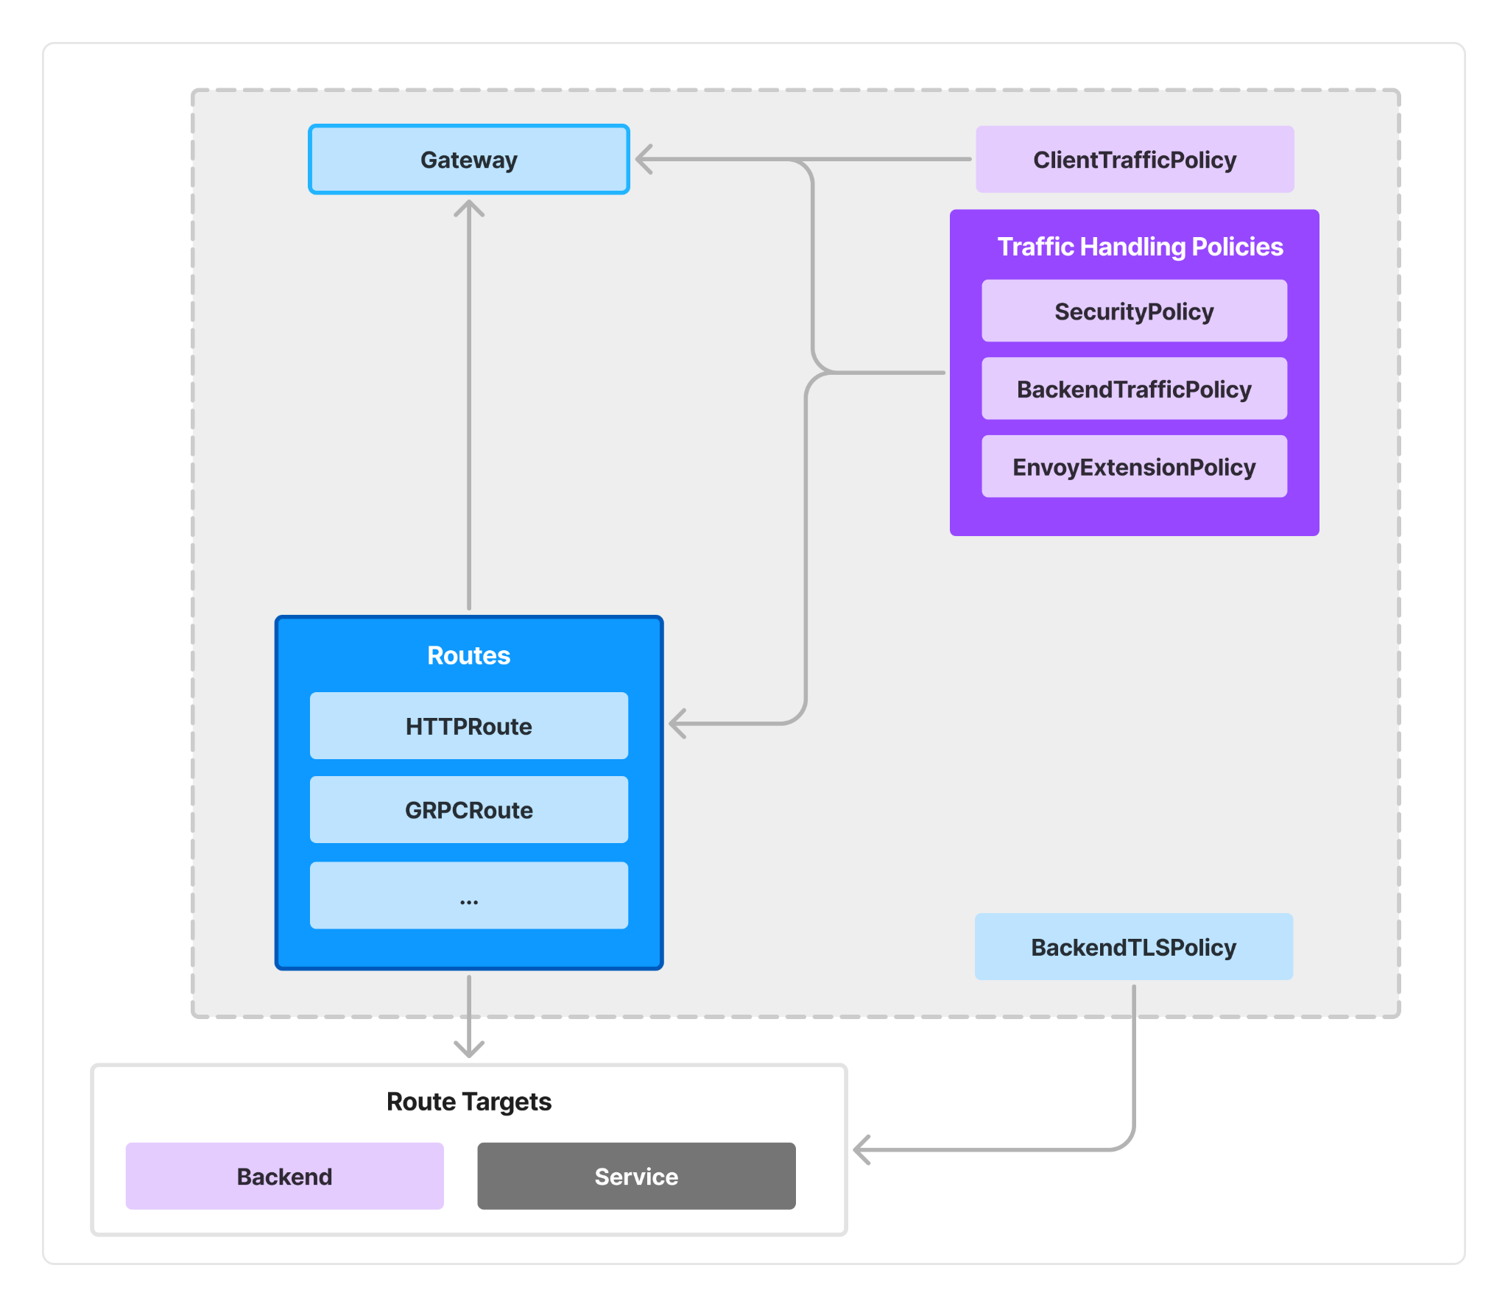
Extending Envoy for AI Gateway
Notes:
This slide illustrates the core structure of Envoy AI Gateway and its key components.
At the top, we have the central Gateway component, which serves as the entry point for managing traffic and policies
We define routes to direct traffic based on specific protocols.
On the right, you’ll see various Traffic Handling Policies— these policies allow us to control access, enforce security, and handle traffic effectively

Slide 9
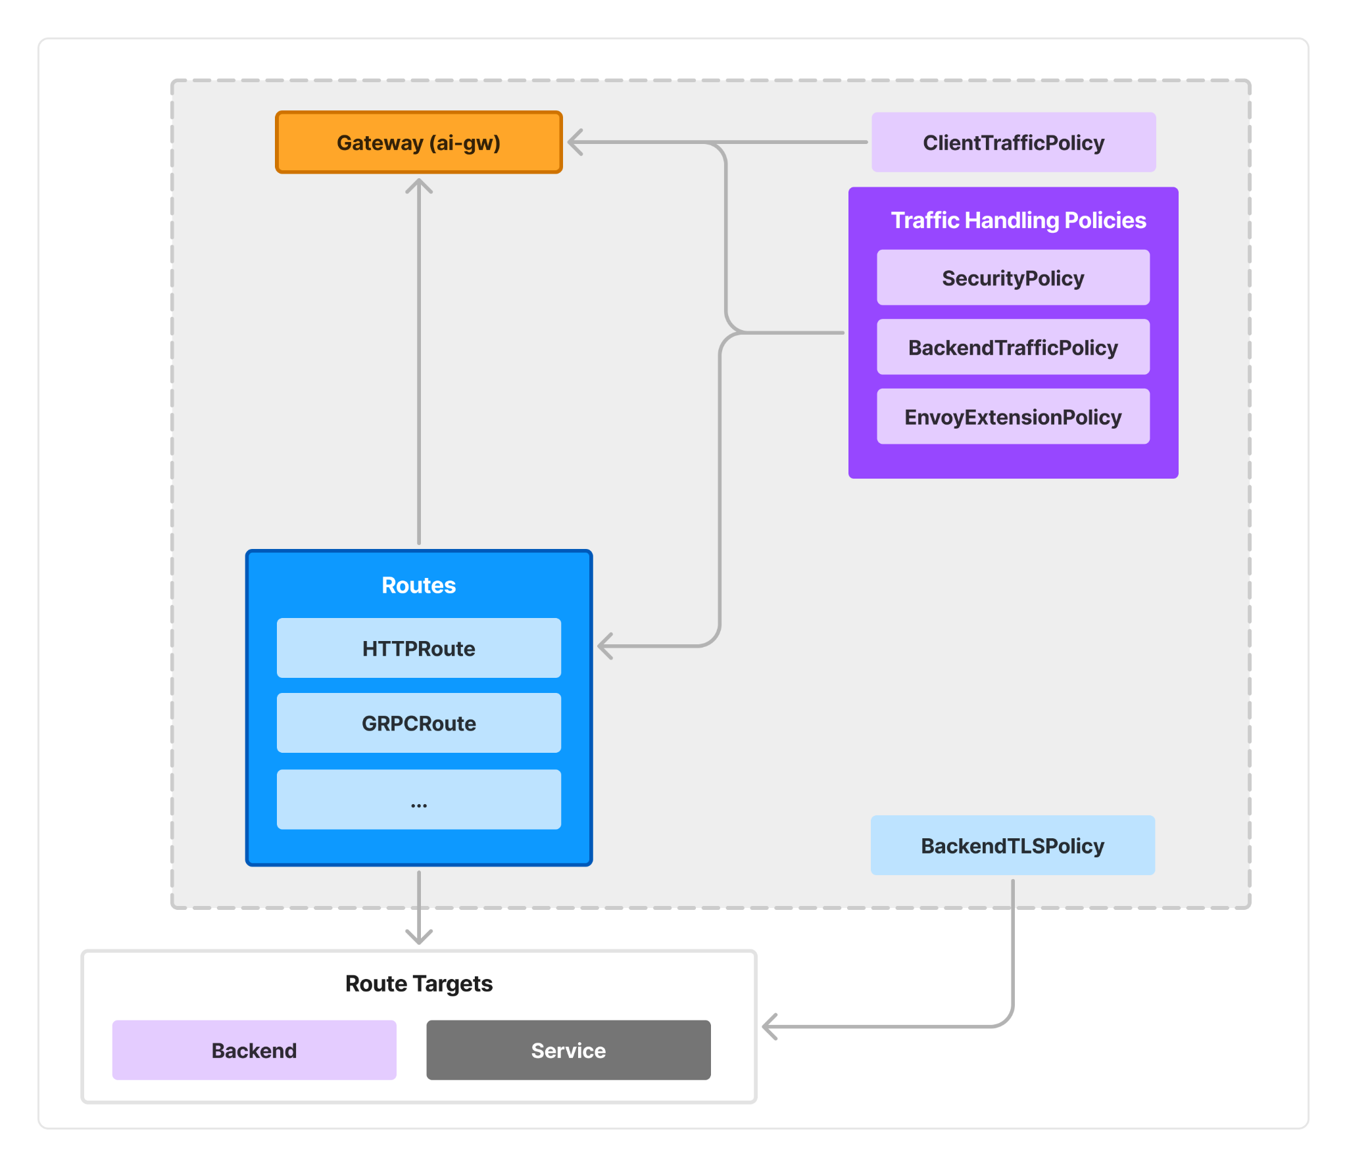
Extending Envoy for AI Gateway
Notes:
Building on the previous structure, this slide introduces a more specialized Gateway component, specifically tailored for AI workloads.
Along with the gateway component we add other ai specific components as well

Slide 10
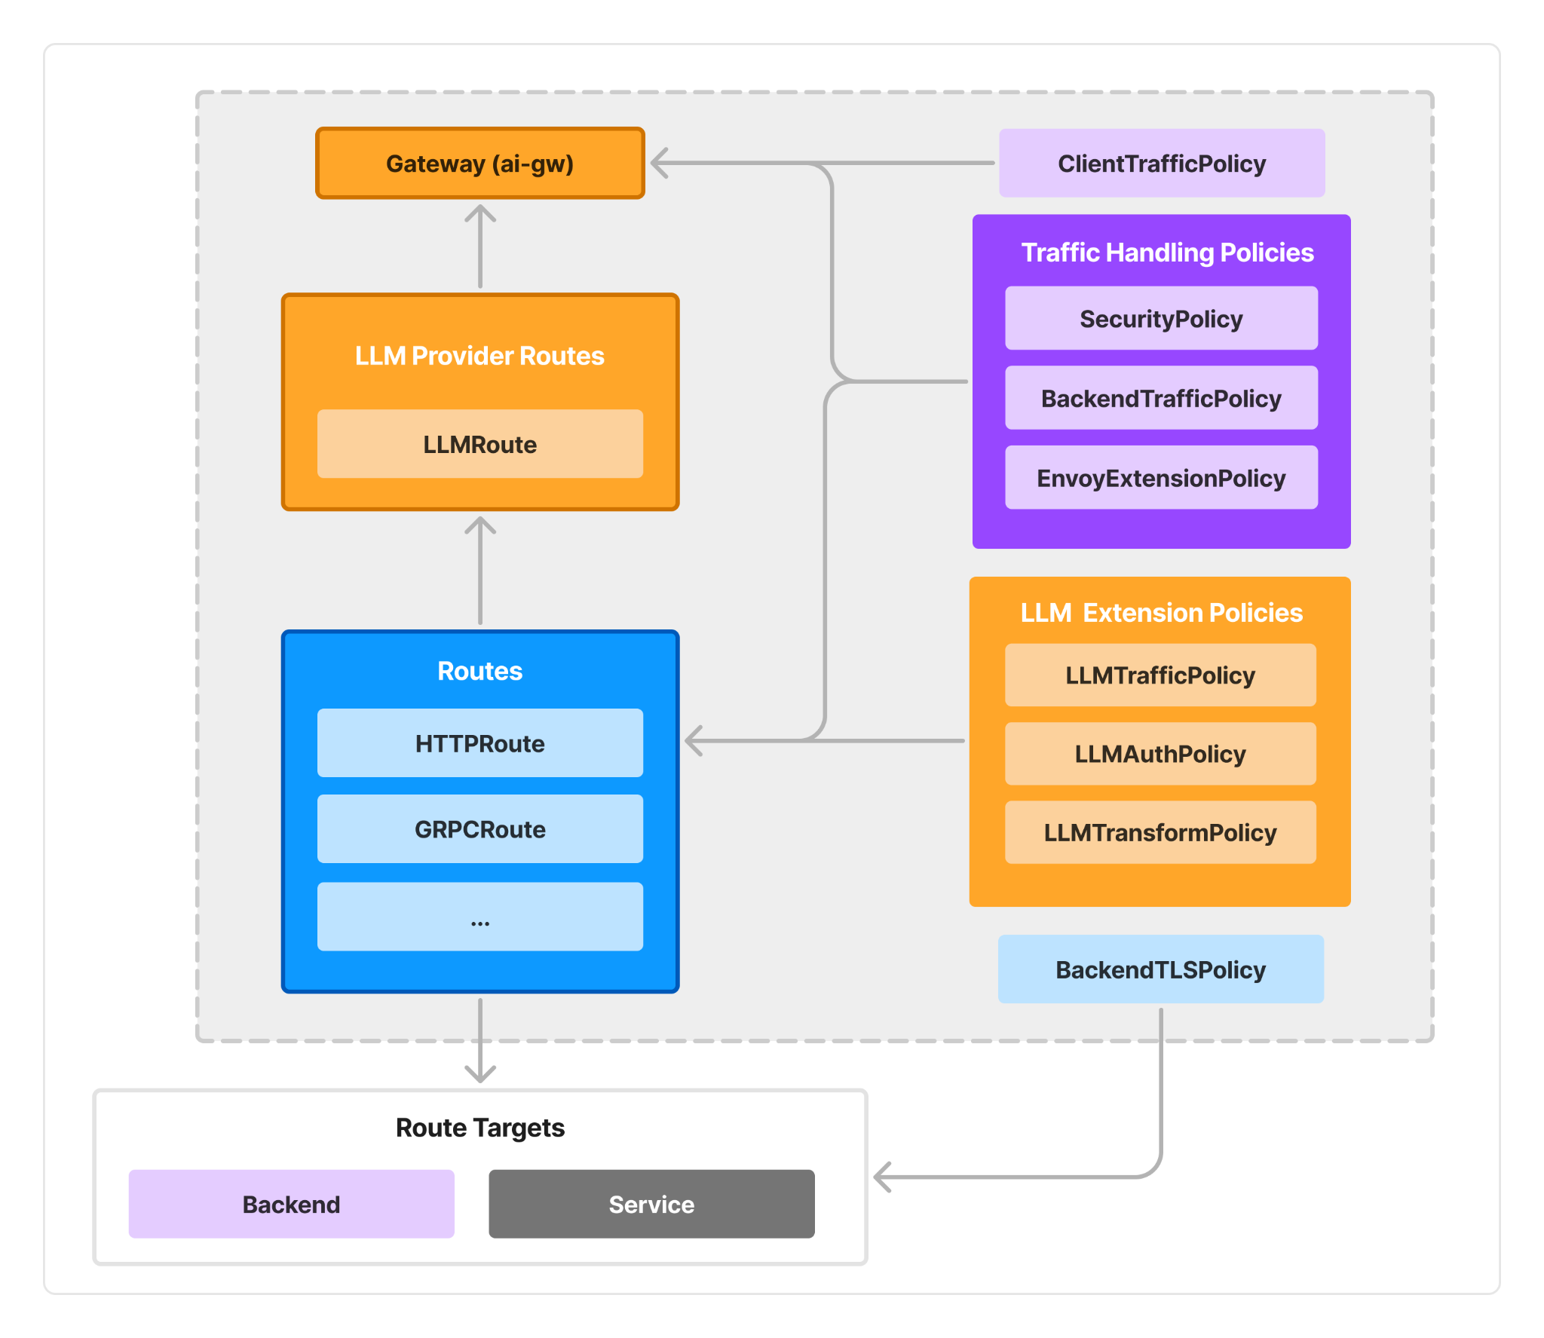
Extending Envoy for AI Gateway
Notes:
We introduce additional layers designed for managing LLM (Large Language Model) providers and their unique requirements.
We now have a dedicated LLM Provider Routes optimized for routing to large language model services.
On the right, we see LLM Extension Policies that enable fine-grained control over traffic, authentication, and transformations.
This also again highlights how Envoy AI Gateway builds on Envoy’s extensible foundation, allowing us to seamlessly add specialized features for AI and LLM workloads, making it adaptable and powerful for complex, modern AI infrastructures.

Slide 11

Envoy AI Gateway: Key MVP Features
Usage Limiting
Unified API
Client & Upstream
Authentication
Notes:
Now, let’s dive into the key MVP features of Envoy AI Gateway that make it a powerful tool for AI infrastructure management.
We’ll cover usage limiting, unified API, and client and upstream authentication as essential components of the gateway.

Slide 12

Usage Limiting
Controls LLM usage based on word tokens, ensuring cost-effectiveness and operational control.
Token Rate Limiting by Provider, Model and Client
Per LLM Provider: Limits can be applied at the provider level to account for different computational costs and capacities.
Per Model: Each model has unique resource needs, so rate limits can be customized per model.
Per Client: Ensures equitable usage and provides tailored limits based on each client's needs or service level.
TOKEN LIMIT:
3/3
Notes:
Usage limiting allows us to control LLM usage based on word tokens, which helps ensure cost-effectiveness and operational control.
We can set token rate limits at different levels: by provider, by model, or by client, allowing us to tailor limits to meet specific needs.
This feature prevents overuse and keeps costs under control, especially with high-demand models.

Slide 13


Unified API
Simplifies client integration with multiple LLM providers, offering a seamless interface.
ACCESS
PASS
ACCESS
PASS
ALL
ACCESS
PASS
OpenAI
Protocol
Compatible
ACCESS
PASS
GCP Vertex
AWS Bedrock
Azure OpenAI
Notes:
The Unified API simplifies client integration with multiple LLM providers, providing a seamless interface for interaction.
With a single API, clients can easily access different providers— Azure OpenAI, AWS Bedrock, Google Cloud Vertex, and others—without complex custom integrations.
Envoy AI Gateway implements an OpenAI compatible protocol, initially supporting completion and chat completion endpoints.
This unified approach greatly reduces integration overhead and streamlines client access to multiple models.

Slide 14
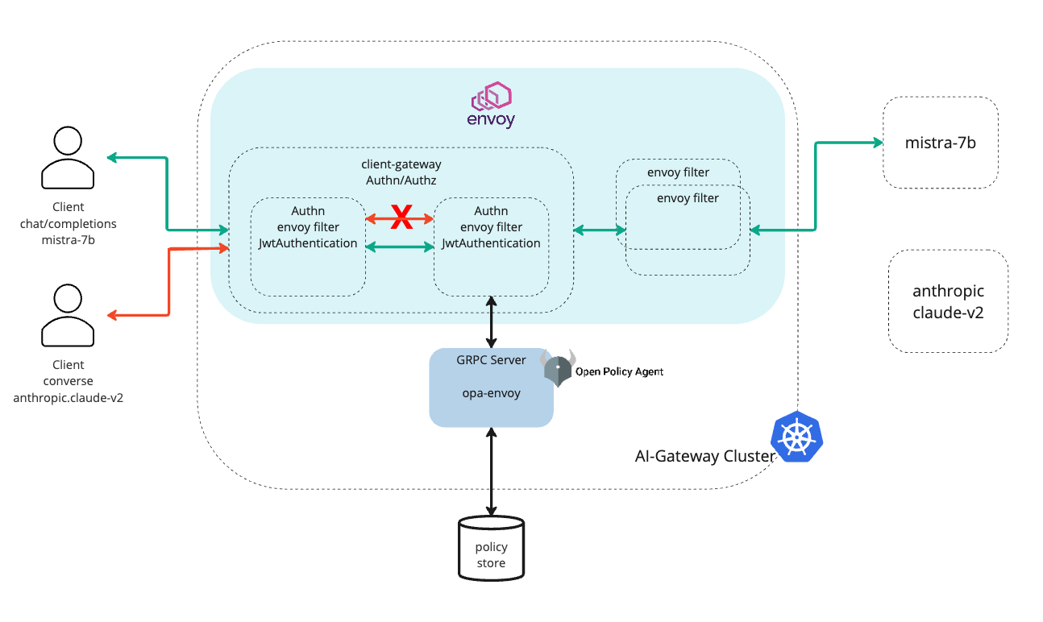
Client and Upstream Authentication
Easily configure and manage credentials across multiple upstream providers, supporting secure, multi-cloud, and hybrid environments.
Notes:
Envoy AI Gateway makes it easy to configure and manage credentials across multiple upstream providers.
This supports a secure, multi-cloud, and hybrid environment, allowing clients to authenticate seamlessly across various models.
By simplifying authentication, we can better secure and scale our AI workflows in different cloud settings.

Slide 15
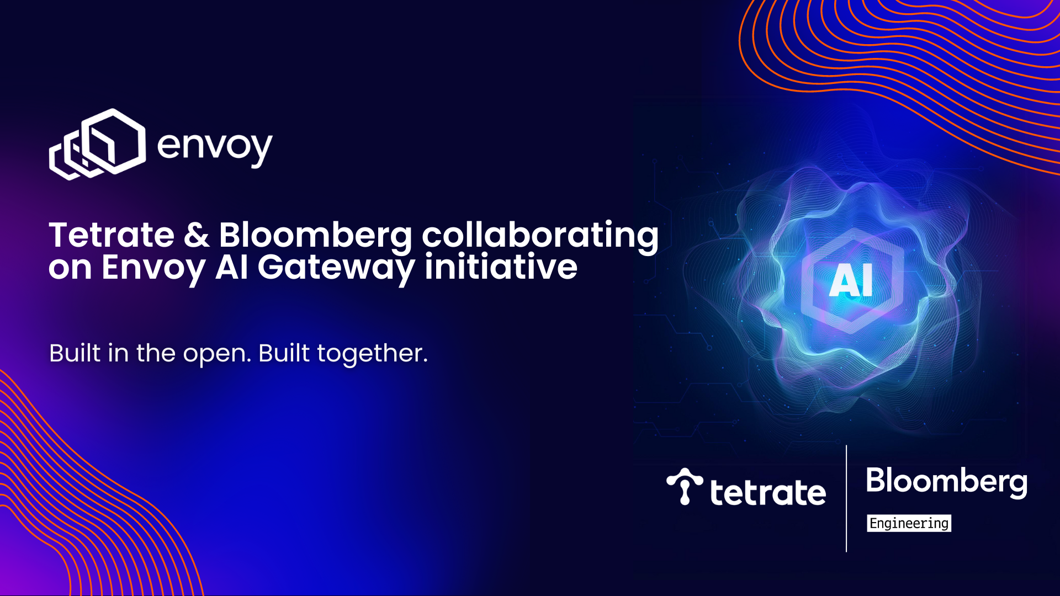


Join the Envoy AI Gateway Community
Get involved to contribute & share your use cases
Join #envoy-ai-gateway on Envoy Slack
Raise issues in the ai-gateway repo within the Envoy Proxy GitHub project: https://github.com/envoyproxy/ai-gateway
Join Envoy AI Gateway community meetings
Follow Envoy!
LinkedIn
X
Notes:
Finally, I’d like to invite you to get involved with the Envoy AI Gateway community.
Join our #envoy-ai-gateway channel on Envoy Slack, raise issues or contribute in our GitHub repo, and attend community meetings to share your use cases.
You can also follow Envoy on LinkedIn and X to stay updated on new developments.
We look forward to collaborating with you and hearing your feedback as we continue to build out the Envoy AI Gateway

